Slide 1
IMDB Database INFO – 6210 | Fall - 2016
Presented By :
Ayon Kar
Prashant Vikram Singh
Tapadyuti Maiti

Slide 2
1. What IS AN IMDB DATABASE?
The Internet Movie Database (abbreviated IMDb) is an online database of information related to films, television programs and video games, including cast, production crew, fictional characters, biographies, plot summaries, trivia and reviews, operated by IMDb.com, Inc., a subsidiary of Amazon.com.

Slide 3
Main Objectives :
Created the IMDB Database to capture all the data related to IMDB site and its requirement
Database is maintained with referential integrity by implementing various procedures, functions, triggers
Calculation for Rating of Movie/TV , No of Tickets/Seats Available at Theater, Fetching Upcoming Movies is implemented
View Tables of Top Stars, Working Crew and Movies on Demand have been maintained for most iterative queries in Database
Back up Database is also created on request , implemented by procedure

Slide 4
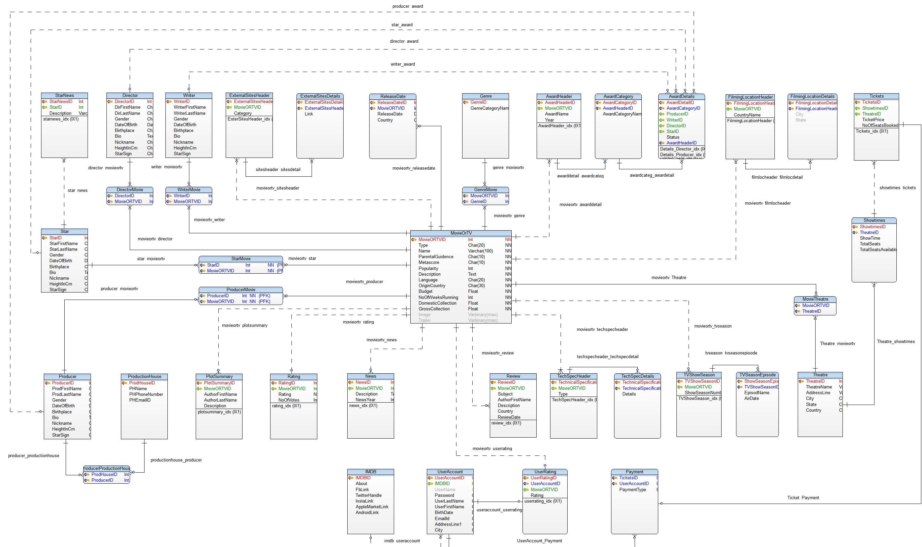
Toad Data Modeler

Slide 5
Learning Outcomes :
List all the Movie/TV Series where the ‘female’ star has acted and the Genre Category is ‘Family’
List the TV Series and the total number of awards won by that TV Series
Give me a list of genre names with highest gross collection for each genre .Also, calculate the total revenue. Make sure the status is 'Nominated' for those movies
List the movies with total number of tickets sold. Rank in descending order
Give me the list of movies for each genre with highest rating and display the release date

Slide 6
THANK YOU

